Slide 1

Azure Fundamentals
Luke Murray
https://www.linkedin.com/in/ljmurray/
https://twitter.com/lukemurraynz

Slide 2
Azure readiness
New IT reality
Implementation
Service Model
Hybrid cloud
Public cloud
off-premises
SaaS (Software as a Service)
(Microsoft Dynamics Online, Office 365, etc.)
Commodity
Application Modernization
PaaS (Platform as a Service)
(Windows Azure Database, Web, Worker, etc.)
Infrastructure Modernization
IaaS (Infrastructure as a Service)
(Windows Azure Virtual Machines)
Cost and Savings
Private cloud
on-premises
Optimized workloads for Private IaaS VMs
Workloads

Slide 3
Azure readiness
Software and hardware refresh
Security threats
(e.g., Spectre)
Urgent capacity needs
Compliance
(e.g., GDPR)
Quickly integrate acquisitions
Application innovation, delivering applications faster
Software end of support (e.g., VMware, Windows Server, SQL Server)
Datacenter contracts expiry
Client Migration triggers to Azure

Slide 4
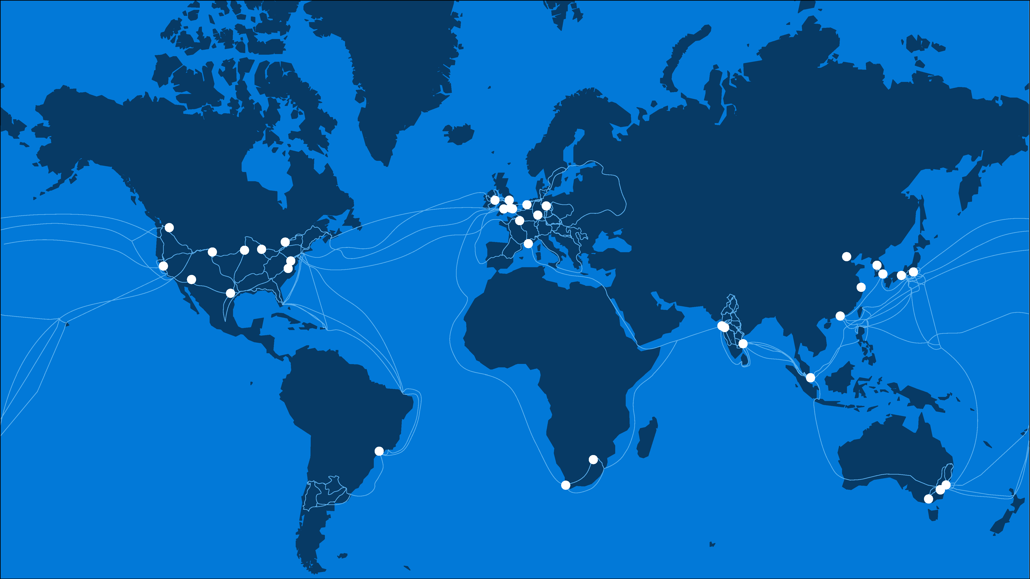
50
40+
130+
AZURE REGIONS
PEERING LOCATIONS
EDGE SITES
Notes:
Our first stop is our global WW presence
As you saw in Scott’s keynote Azure has 42 regions WW which is more than any other cloud provider
These regions are actually comprised of hundreds of DCs
We also operate one of the most robust and reliable networks in the world with:
over 4500 points of presence
And more than 130 Edge sites

Slide 5

Azure datacenters
Azure (commercial)
Azure Government
Azure Government Secret
Azure Government Top Secret
DoD Impact Level 2 (IL2)
DoD Impact Level 4 (IL4)
DoD Impact Level 6 (IL6)
ICD 503 (in progress)
ICD 705
FedRAMP High
DoD Impact Level 5 (IL5)
ICD 503
HIPAA
FedRAMP High
JSIG (PL-3)
JSIG (PL-3)
ITAR, DFARS
IRS 1075, CJIS, HIPAA

Slide 6
One program, two different business models
CSP Direct
CSP Indirect
CSP Direct model (1-tier)
Partner works with Microsoft directly
Fixed discount for Azure
Partner needs to provide billing tools and build support practice
Credit check during the onboarding process
Microsoft
Microsoft
CSP Indirect Provider
CSP Direct Partner
CSP Indirect model (2-tier)
2 partner tiers:
CSP Indirect Provider (aka Distributor) – transacts to Microsoft, provides billing tools and technical support.
CSP Indirect Reseller – sells Azure to customers through CSP Indirect Provider.
CSP Indirect Reseller
Customer
Customer

Slide 7

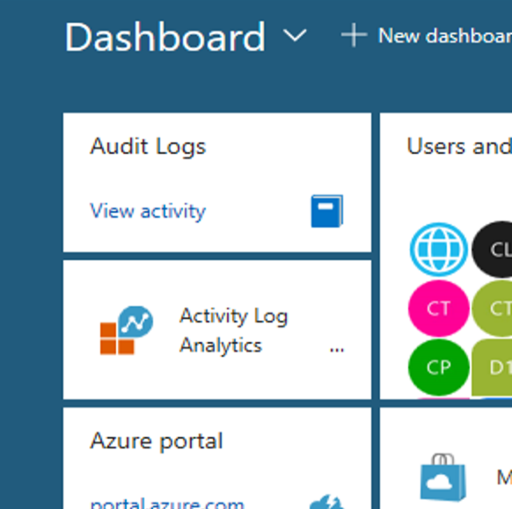
Azure portal offers enterprise-grade management
Govern
Secure
Policy management
Cost management
Security management
Threat protection
Azure portal
Configure
Protect
Update management, scripting automation, configuration
Backup and disaster recovery
Monitor
App, infrastructure and network monitoring log analytics, and diagnostics

Slide 8
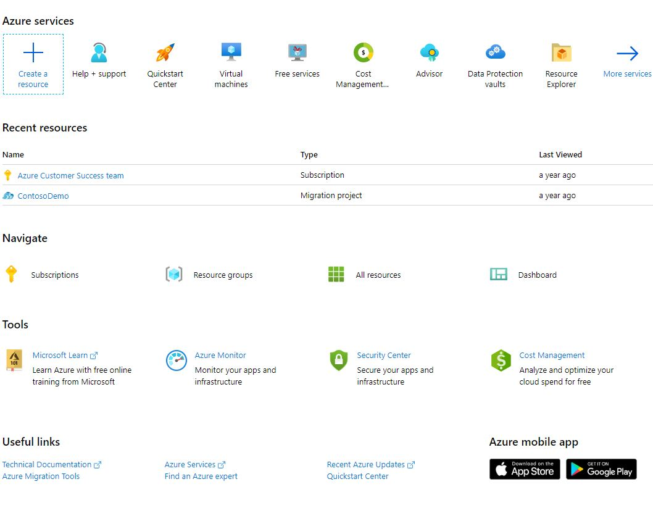
Azure portal is customizable—portal.azure.com
Create portal dashboards
By key roles, (e.g., operations, finance, development), key projects, and key service KPIs

Slide 9

Azure mobile app
Now available on Android and iOS
Download the app today.
Stay connected to your Azure resources—anytime, anywhere
Monitor and manage your Azure resources on the go
Quickly diagnose and fix issues from your mobile device
Dark theme supported
Get notifications and alerts about important health issues
Run Azure Cloud Shell scripts (PowerShell or Bash) from the app
Learn more
Check product availability in your region
Easily access Service Health events and information
Receive Azure Alerts as push notifications via action groups

Slide 10
Azure Quickstart Center
Accelerate your Azure deployment
Not quite ready to launch a project? No worries
Need more learning resources? We have you covered
A focused view of the top Azure services guides you through options to help you easily build, test, and deploy your project to the cloud.
Built in setup guides enable you to make decisions as you prepare to migrate or drive innovation with Azure services.
Our recommended learning paths let you take a hands-on approach to building Azure skills and knowledge.
More information: https://aka.ms/aqc. Watch videos on Microsoft Mechanics and Azure Friday.

Slide 11
Azure policy for enterprise cloud control and compliance
Enforcement and compliance
Apply policies at scale
Remediation
Turn on built-in policies or build custom ones for all resource types
Apply policies to a Management Group with control across your entire organization
Real time remediation
Remediation on existing resources
Real-time policy evaluation and enforcement
Apply multiple policies and aggregate policy states with policy initiative
Periodic and on-demand compliance evaluation
Exclusion scope

Slide 12
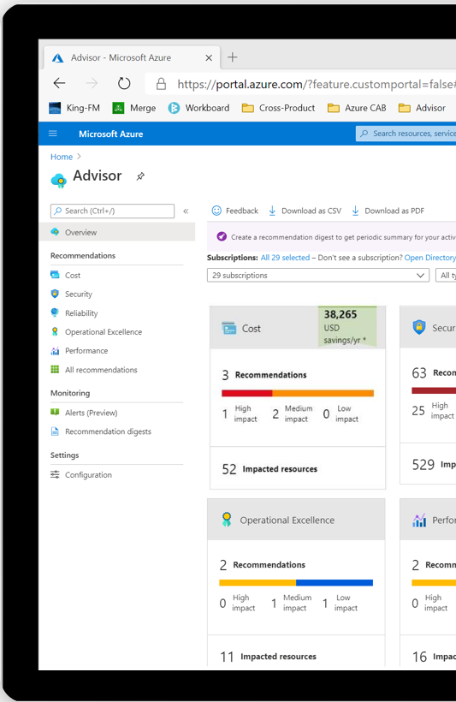

Azure Advisor
Your free, personalized guide to Azure best practices
Optimize your Azure resources for cost, security, high availability, performance, and operational excellence
Quickly and easily act on best practice recommendations with simple, step-by-step guidance and quick links
Find all your optimization recommendations from across Azure in one place
Get notified about new recommendations and recommendations you haven’t actioned yet
More information: Learn more about Azure Advisor

Slide 13
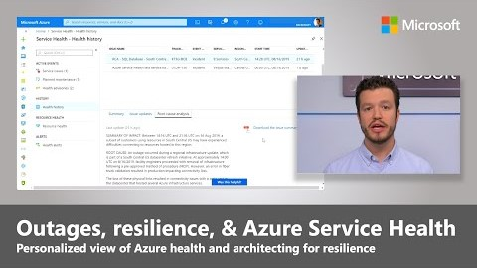

Azure communicates incidents, upcoming maintenance, and health advisories via Azure Service Health
Azure Service Health alerts is strongly recommended
Examples of alerts include:
An alert to email your dev team when a resource in a test/dev subscription is impacted
An alert to update ServiceNow via webhook when a resource in production is impacted
An alert to send an SMS to a specific number when resources in a given region are impacted

Slide 14
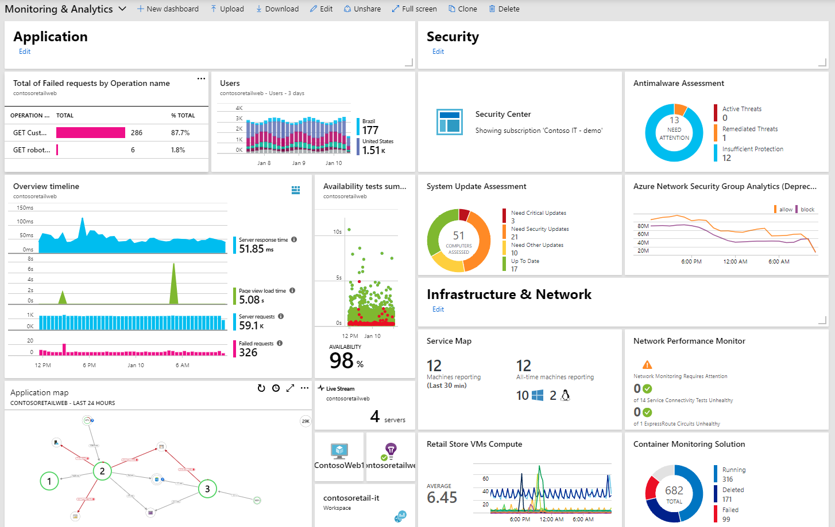
Azure Monitor aka.ms/AzMonOverview
Detect & diagnose issues across apps and dependencies with App Insights
Correlate issues at infra level with insights for VMs, AKS, SQL, Networks, etc.
Drill down with Log Analytics for troubleshooting & deeper diagnostics
Operationalize at scale with Smart Alerts & Automated Actions
Create visualizations with Azure Dashboards & Workbooks

Slide 15

Global: Unique across all of Azure
Example: Names of PaaS resources with Public IP endpoints must be unique across all of Azure,
because that name is the initial default public DNS name.
Resource Group: Unique within the resource group
Example: All virtual networks in a resource group must have a unique name for routing
within that resource group.
Azure
Resource
Group
Resource
Resource Attribute: Unique within the parent resource
Example: All subnets within a virtual network must have unique names
to avoid segment overlap.

Slide 16



Infrastructure as a Service
VM
VM Scale Set
Containers
Marketplace
Legacy applications, no change
Scale out
Efficiency and speed
Flexibility
Lift and shift
Elasticity
Improved DevOps
Managed Service

Slide 17
Compute Options for all Types of Apps
Entry level
Burstable
General Purpose
Compute Intensive
Storage Optimized
A
Av2
B
D
Dv2
Dv3
F
Fv2
L
Memory Optimized
Graphics Intensive
High Performance Computing
Purpose-built SAP HANA
G
Ev3
M
NC
NCv2
NV
ND
H
HANA
NCv3
NCv2
NCv2
(coming soon)
(coming soon)

Slide 18
Azure protection options for all scenarios Introducing Availability Zones, protecting from datacenter level failures
Blast radius
Region
Data Residency boundary
Availability
Datacenter
Region 1
Region 2
Zone 1
Availability
Availability
Zone 2
Zone 3
Availability Sets
High Availability protection from hardware failures in a datacenter
Availability Zones
High Availability protection against loss of datacenters; Multiple datacenters per physically separated zone; each zone features independent network, cooling, and power
Region Pairs
Protection for your data and applications from the loss of an entire region with Geo-Redundant Storage (GRS) and Azure Site Recovery

Slide 19
Availability Zones Part of Azure’s native HA/DR solutions, providing protection from datacenter failure
Data Residency boundary
Region
Region
Region 1
Region 2
Zone 1
Zone 2
Zone 3
Zone 1
Zone 2
Zone 3
Run mission-critical applications with 99.99% SLA
High Availability supported with industry best SLA when two or more VMs are running in separate Availability Zones within a region

Slide 20






Azure Routing
Azure Region 1
Azure
Hub
Hub
VNet Peering
S2S VPN Tunnel
S2S VPN Tunnel
P2S VPN
S2S VPN
ExpressRoute
From Internet
Customer Networks

Slide 21
Cloud Services - ARM
New Azure Resource Manager (ARM)—based deployment model
Increase availability with built-in regional resiliency.
Feature parity with Azure Cloud Services deployed using Azure Service Manager (ASM).
Access ARM capabilities such as role-based access and control (RBAC), tags, policy, and deployment templates.
Preview
Cloud Services (classic)—ASM
Cloud Services (extended support)—ARM
Documentation
Build regionally resilient cloud services using Azure Resource Manager

Slide 22
Pace of innovation | capabilities
1076
1025
915
610
369
315
210

Slide 23
Azure retirements
Azure is 12 years old; retirements are part of the natural lifecycle of any service or feature
Retirements do not mean that all Azure customers are impacted
Continuous innovation and modernization of Azure services helps unlock new and better opportunities
It is our commitment to provide customers as much time and information, to plan thoughtfully
Our customer commitment
How we communicate
Where we communicate
When we
communicate
Minimum 12-month notice to remove any material feature or functionality, or discontinue a service*
Minimum 90-day notice to retire anything else
Modern Lifyecycle Policy
Online Services Terms
*excluding Previews
Targeted communications directly to active usage Azure subscriptions
Viewable by anyone with admin permissions on subscription
Authenticated
Health advisory message in Azure Service Health*
Direct email to admins
Unauthenticated
Azure Updates post
Banner messages on retiring service pages
*Set up a Service Health Alert to receive an email, text, vmail, as well
Initial retirement notification per policy
Reminder messages at T-6 months, T-3 months, T-1 month, then weekly until T-0
Will send an update notification if any plans significantly change

Slide 24
Azure AD · Core Reliability Principles
Highly Redundant
Safe Deployment
No single points of failure
Modern Verification
Multiple levels of isolation
Cell-Based Architecture
Independent backup authentication service
Elastic scalability
Notes:
These are the core principles used by Azure AD for reliability.
The service is run in a highly redundant manner -- within a data center all data is replicated at least 9 times. We regularly validate the redundancy of the service by exercising failure and fault injection – up to Data Center drills.
We ensure that no single system internal or external can impact the availability of the service and that includes systems like DNS or CDN's where we employ at least 2 active/active systems. To illustrate in July there were some public DNS outages but because Azure AD depends on multiple providers in an Active/Active manner there was 0 disruption.
Our work here is ongoing to continually improve the resilience of the service. One area is our Cell-based architecture:
The service has multiple levels of logical and physical isolation. Our strongest isolation are our physical cells that are analogous to compartments in a submarine and are designed to contain faults and maintain the integrity of the vessel or in this case Azure AD even if there is a fault in a given compartment. In the next few months we're actively evolving the service from 5 cells to over 50 with plans to get into the hundreds beyond that. At this point, 60% of overall Azure AD traffic has been migrated, and we’re on track to complete 100% of traffic migration by end of June.
However, in the March outage the core Azure AD systems were still operational so this layer did not help.

Slide 25
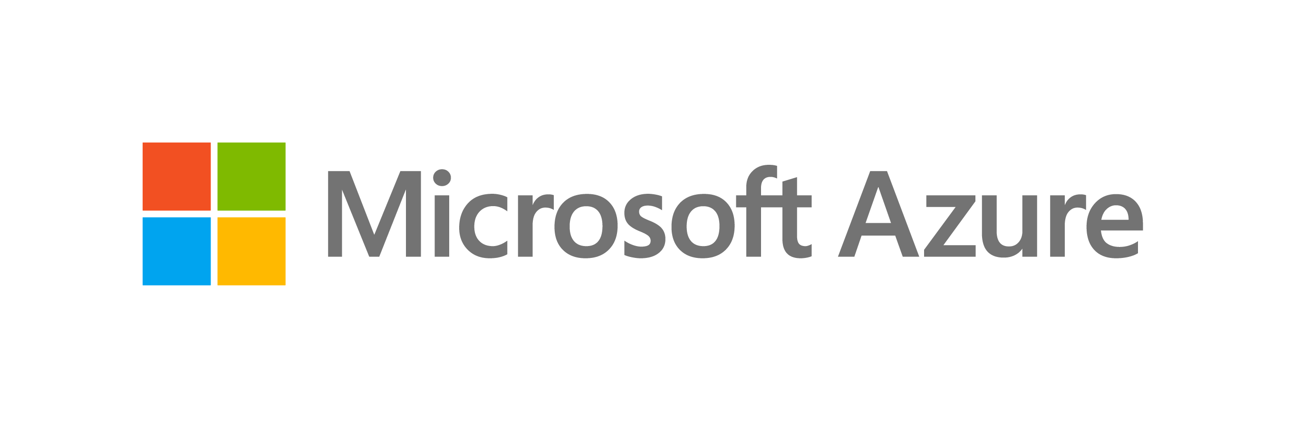
Azure products
AI + Machine Learning
Media
Analytics
Hybrid
Blockchain
Migration
Compute
Mixed Reality
Containers
Mobile
Databases
Networking
Developer Tools
Security
With over 6,000 services, Azure has a wide range of flexible offerings. Azure draws on Microsoft's vast data capacity to provide software, platform, and infrastructure as a service.
DevOps
Storage
Identity
Web
Integration
Windows Virtual Desktop
Internet of Things
Microsoft Game Development
Management

Slide 26




Azure Functions
Python, PowerShell users can now create serverless workflows to orchestrate complex data processing and data science workloads in Azure Functions.
Learn more.
Check product availability in your region.
Events
Code
Outputs

Slide 27
Azure Spot Virtual Machines
Public Preview
March 2021
Improved runtime and ease of use
Simulate Evictions
Using REST API
Try/Restore
Automatically try and restore
evicted VMs
Available now in Preview
Available now in Preview
Access the new capabilities via the Azure portal.
Documentation.

Slide 28
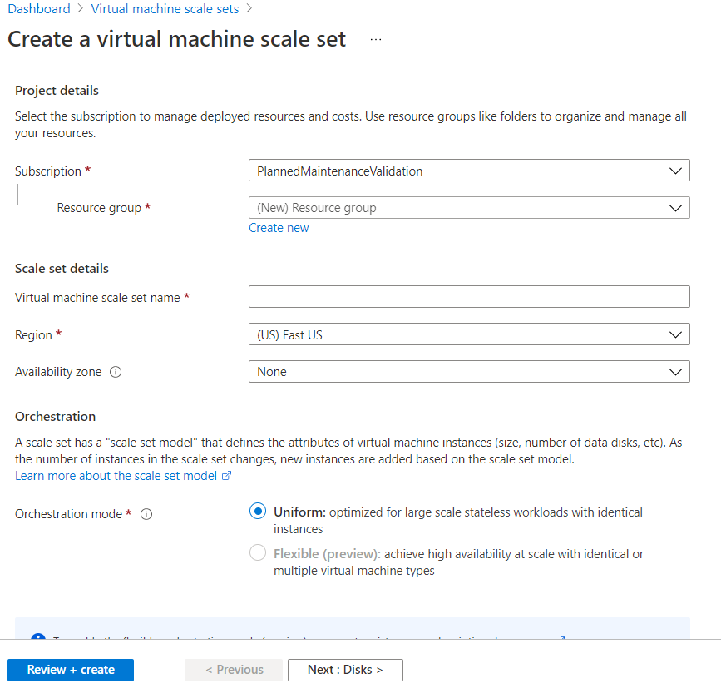
Virtual Machine Scale Sets
Preview
Flexible orchestration mode
Simplified management and scalability
Increased application resiliency
Greater operational agility
Read the documentation
Visit the website

Slide 29
Azure Disk Storage
Upcoming (March – June 2021)
ZRS support for Azure Managed disks (GA)
Performance tiers w/o downtime (GA)
Cross-region snapshot copy (preview/GA)
Disk attach/detach latency improvements (preview/GA)
Ultra Disk region expansion (ongoing) (GA)
Learn more about Azure Disk Storage
Azure Disk Documentation
Stay up to date with the latest releases on the Azure Blog
Standard HDD
Standard HDDs2,000 IOPS and 500 MBps
Premium SSD
Premium SSDs 20,000 IOPS and 900 MBps
Standard SSD
Standard SSDs 6,000 IOPS and 750 MBps
Ultra Disk
Ultra Disk 160,000* IOPS and 2000 MBps

Slide 30
Azure Image Builder Service
Azure VM Image Builder Service
Images creation for multiple scenarios:
Create Linux, Windows Server and Client images for Azure, and Azure Stack.
Use existing image security configurations to build compliant images.
Patch existing custom images, using Linux commands or Windows Update
Support for multiple Linux distros, Windows Virtual Desktop environments, Azure Market Place images etc.
Build images for specialized VM sizes, such as creating images for GPU VM sizes.
Full Image Management:
In combination with the Azure Shared Image Gallery, you now have a complete image management system, with image patching, versioning, regional replication, and role-based access control.
Documentation
Private Preview announcement and sign up page
Create and Store Template
Template
Source
Customizations
Distributions
Output
Image builder resource provider
Run Image Build
Create Build Pipeline
VHD
Managed image
Shared image gallery

Slide 31
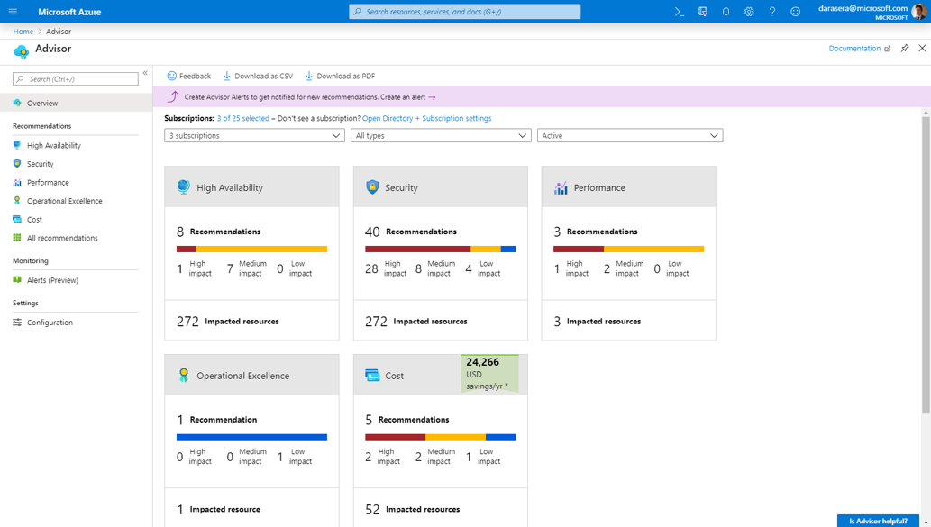
Azure Kubernetes Service (AKS) Built-in best practices
Kubernetes Cloud adoption framework
Consolidation and sharing of best practices about Kubernetes adoption from Microsoft employees, partners, and customers (details).
Learn new skills and discover the power of Azure Kubernetes Service and other Microsoft products with step-by-step guidance.
Explore cost optimization strategies to use on Azure for your cloud-native application development process by using Azure Kubernetes Service (AKS) (details).
Cloud native applications on Azure
).
Azure Kubernetes Service
Azure Advisor

Slide 32
Azure SQL Database Geo-replication for Hyperscale
Perform quick disaster recover of your Hyperscale databases
Create up to four readable secondaries on Hyperscale in different regions.
Use geo-replication load balance read-only workloads and provide access to data in multiple regions.
Store full backups for up to 10 years.
Easily restore your backups as a new database.
Check product availability in your region.
Up to 4 secondaries

Slide 33
Service Bus
Reliable cloud messaging as a service (MaaS) and simple hybrid integration
Java Message Service (JMS) support—Public Preview—ETA Q1 2021.
Customers can now lift and shift Java workloads from on-premises or IaaS environments to leverage the best of Azure’s PaaS offerings.
Support for large messages—Public Preview —ETA Q1 2021.
Service Bus will support message sizes up to 100 MB.
Learn more
Message sender
Service Bus Namespace
Message receiver
Web App
Queue
Service or Application
Mobile App
Service

Slide 34
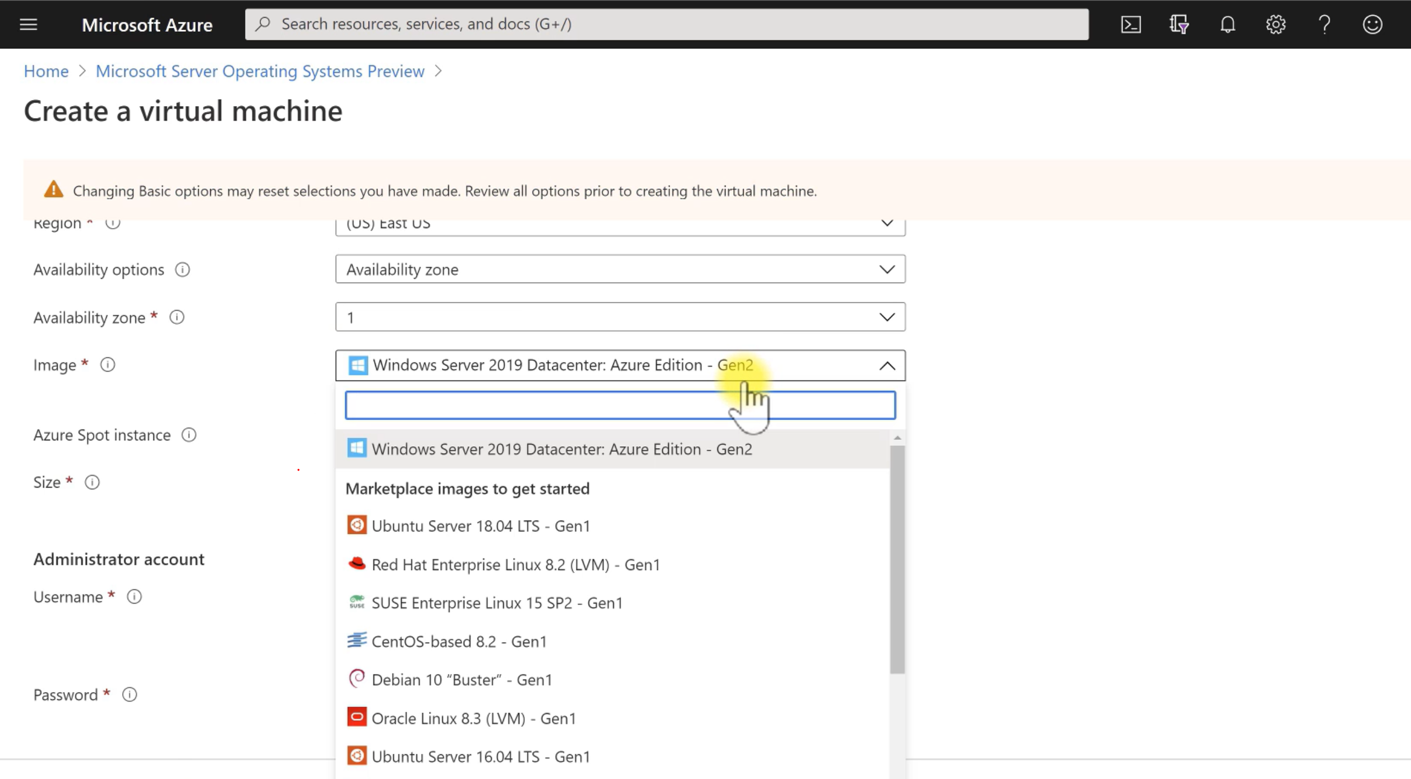
Azure Automanage for Windows Server & Linux
Public Preview
Eliminate downtime for apps and services running on Windows Server
Deploy security patches in seconds without reboot
Help protect against critical threats
Automatic enrollment for ease of service discoverability
Support for all major Linux distributions— CentOS, RHEL, Ubuntu, and SLES
Key services include backup, monitoring, update management, security center, and more!
Learn more

Slide 35









Azure Front Door Standard & Premium Secure Cloud CDN with Intelligent Threat Protection.
Region 1
Intelligent Security Protection
WAF, DDoS and Bot Manager protection
Integrated Private Link service to access resources securely
Powered by Microsoft Threat Intelligence
Dynamic App Acceleration
SSL offload and dynamic app acceleration at the edge
Instant scalability with global HTTP load balancing and fail over
Azure-managed domain and TLS cert experience DNS + Key Vault
Fast Global Content Delivery Network(CDN)
Built on Microsoft massively-scaled private global network
Supports static/dynamic content caching, file, OTT and VOD
Low latency, high thru-put from cloud or on-prem to global users
Cloud-native and Developer Friendly
Fully REST API driven to automate and streamline deployment
Tightly integrated with Azure services including App Service, Storage, API Manager, App Gateway and Azure Sentinel
Global Edge Locations
Region 2
Users on Public internet
/*
/search/*
/statics/*
www.contoso.com
Azure Front Door
Region 3
Microsoft Global Network

Slide 36

Azure VMware Solution by CloudSimple - Components
On Prem VMware
Microsoft Azure
Cloud Admin
Dev/User
Azure Portal
VMware vCenter
Azure Management
Azure Service Integration Platform
VM
VM
VM
VM
ESXi Hosts
Azure Services
AD, Storage, Security
Storage
Network
VMware vCenter
VM
VM
VM
VM
Third-party Services
Zerto, Veeam, etc.
On-Premises
Datacenter
ESXi Hosts
Storage
Network
ExpressRoute and Network Edge Services
Azure VMware Solution
by CloudSimple
Azure bare metal servers

Slide 37

Microsoft Azure Sentinel
Collect
Security data across your enterprise
Cloud-native SIEM for intelligent security analytics for your entire enterprise
Limitless cloud speed and scale
Faster threat protection with AI
Easy integration with your existing tools
Streamlined and cost-effective data collection
Learn more
Check product availability in your region
Respond
Detect
Rapidly and automate protection
Threats with vast threat intelligence
Azure Sentinel
Investigate
Critical incidents guided by AI

Slide 38

Azure Virtual Desktop
Azure Virtual Desktop is a comprehensive desktop and app virtualization service running on the cloud. It is the only service that delivers simplified management, multi-session Windows 10, optimizations for Office 365 ProPlus, and support for Remote Desktop Services environments. The richest Office 365 experience in virtualized environments including support for Microsoft Teams with audio/video redirection.
Learn more and Get started today.
Windows 10
+
Office 365

Slide 39





Azure Files Lift and shift on-prem Apps to Azure Files
Works with Data Box or use Azure File Sync to move data up
Azure File Share
Migrate on-premises apps such as SQL FCI, file processing that use file share storage to Azure.
Application
Application
Reuse existing file-based data access layers in your cloud apps.
File Share
Zero downtime migration for Windows Servers using Azure File Sync
Application
Application

Slide 40
Azure Files Pricing Structure
Choose the best tier for your workload
High IO & Throughput
Low-cost Long-term storage
Premium
Transaction optimized
Hot
NEW
Cool
NEW
Offered on solid-state disk (SSD) storage media and useful for IO-intensive workloads, including hosting databases and high-performance computing (HPC).
Offered on rotational hard-disk (HDD) storage media and useful for general purpose file shares.
Low transaction charges make this tier ideal for larger sets of files with high-churn.
Useful for most general-purpose workloads, including for lifting and shifting an on-premises file share to Azure, and especially with Azure File Sync.
This tier is more useful for lightly used file shares, where data is to be stored for long term access without compromising the capability of instant online access to the data.
Latency: ~3 ms
Max IOPS: 100,000
Max Throughput: 10 GB/s
Latency: ~15-200 ms
Max IOPS: 10,000
Max Throughput: 300 MB/s

Slide 41

PlayFab Multiplayer Servers
Multiplayer Servers Dynamically respond to player demand with the ability to easily and efficiently scale custom multiplayer servers. Go from supporting 100 players to 100,000 (and back) in minutes. Handle peaks in demand without impacting the game experience.
With the proven scale of Xbox and Azure Launch and scale on a global infrastructure, powered by the same multiplayer servers running games like Forza Horizon 4, Rainbow Six Siege, Sea of Thieves, and Halo 5.
Control costs without sacrificing performance By only paying for Azure resources allocated for gameplay, plus a small pool of standing-by machines. Developers have choice to use either Linux or Windows to containerize their game server code.
Documentation | Product page | Read the blog
Check product availability in your region

Slide 42
GOVERN
SECURE
Policy management
Cost management
Security management
Threat protection
CONFIGURE
Microsoft Azure
PROTECT
Configuration
Update management
Automation
Scripting
Backup
Disaster recovery
MONITOR

Slide 43
Additional Resources
What is Azure?
Get started with Azure
Get your Azure free account
Wikipedia - More about Azure and some acronyms (IaaS/Pass)
Create a 3-Tier Application Using Azure Virtual Machines
Microsoft Azure Essentials
Channel9
Microsoft Learn
Microsoft Cloud Training Events
Azure Citadel
70-532 Azure Exam links
Azure Tips and Tricks
Azure Academy
Microsoft Mechanics
Solution Architect: Design Power Platform solutions
Learn Azure in a Month of Lunches – Audiobook
How can I learn how to use Microsoft Azure?

